Slide 1
Airline Risk Analysis
June 2, 2023

Slide 2



Team
Lillian Lakes
Technical Lead
Madeleine Smithers
GitHub Lead
Rajesh Reddy
Presentation Lead

Slide 3

Main Finding
A commercial airline passenger is 75.69% less likely to die in a deadly crash.

Slide 4
Agenda
Business Problem
Data Overview
Data Analysis
Recommendations
Further Steps
1
2
3
4
5

Slide 5
Business Problem

Slide 6

Business Problem
Expand into Aviation Industries
Understand the Risk of Commercial and Private Aviation

Slide 7
Data Overview

Slide 8

Data Overview
Aviation Data from National Transportation Safety Board
Data from 1962 - 2022 (88000+ data points)
Filtered by airline accidents after 2009

Slide 9
Data Analysis

Slide 10
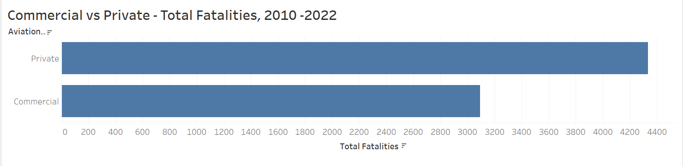
Private Airlines Reported More
Fatalities

Slide 11
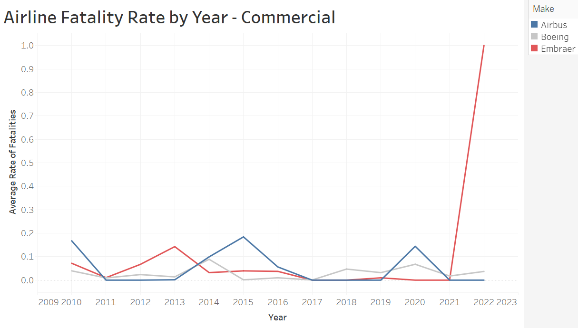
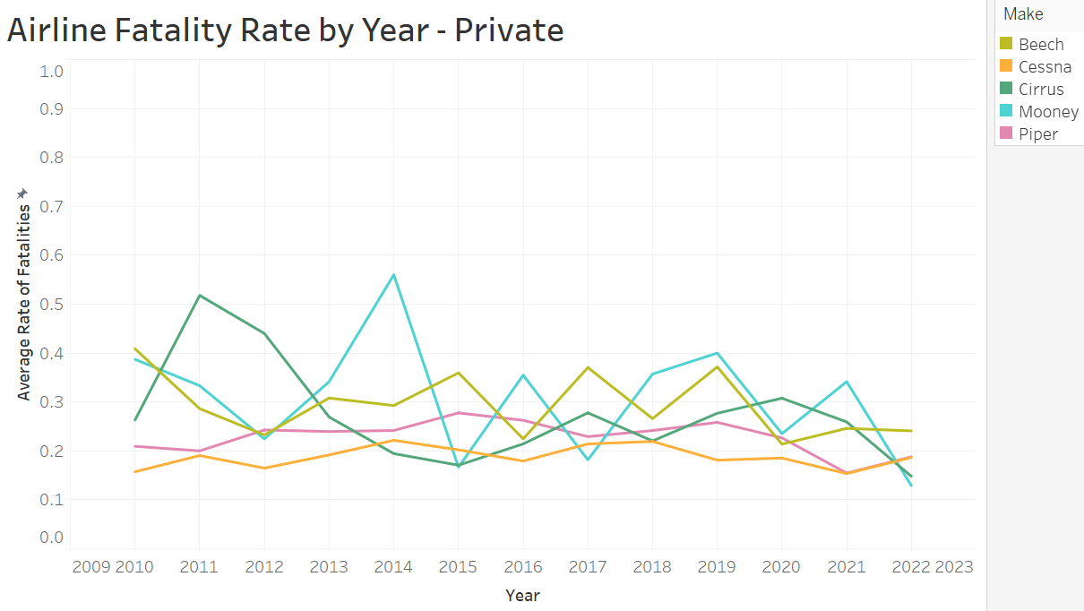
Fatality Rates are Lower in Commercial Airlines
Cessna
Boeing

Slide 12
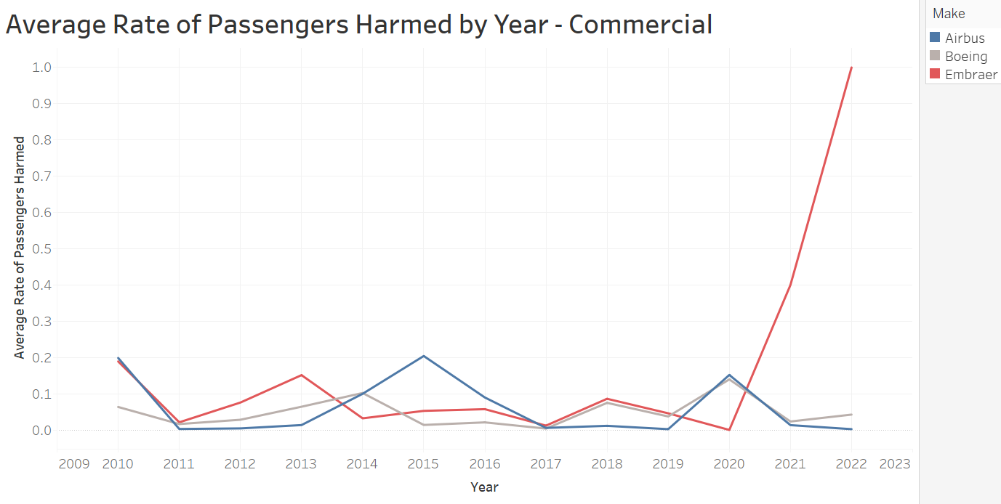
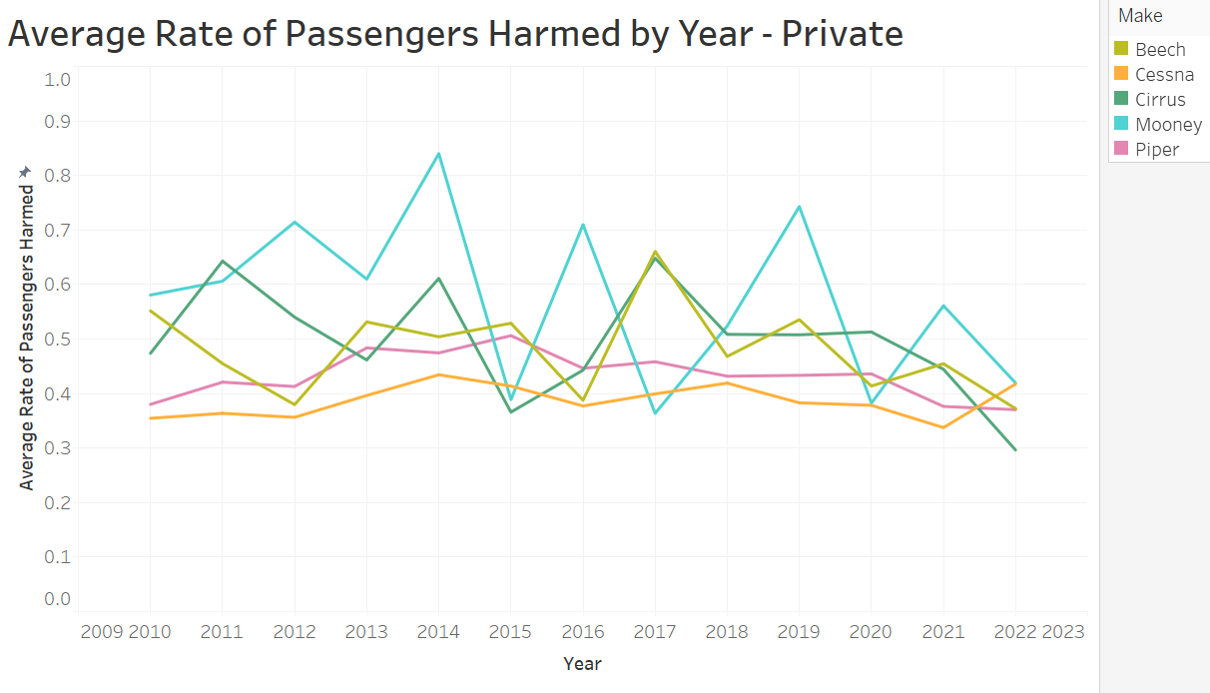
Injury Rates are Lower in Commercial
Airlines
Boeing
Cessna

Slide 13
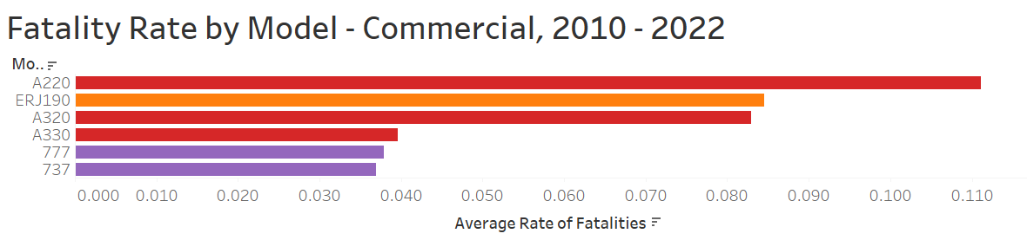
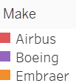
Boeing Has the Lowest Fatality Rate Among Commercial Airlines

Slide 14
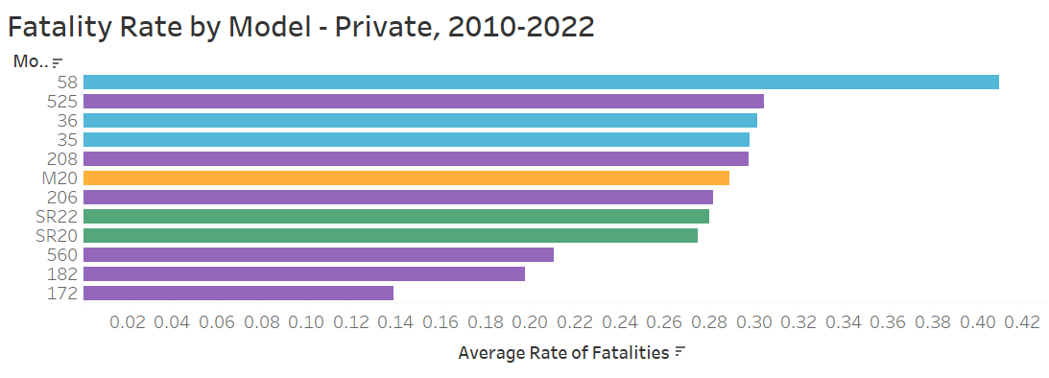

Cessna Has the Lowest Fatality Rate Among Private Airlines

Slide 15
Recommendations

Slide 16
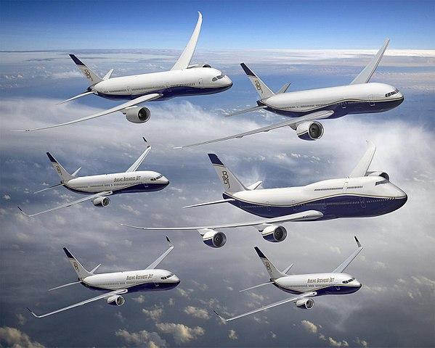
Go Commercial

Slide 17
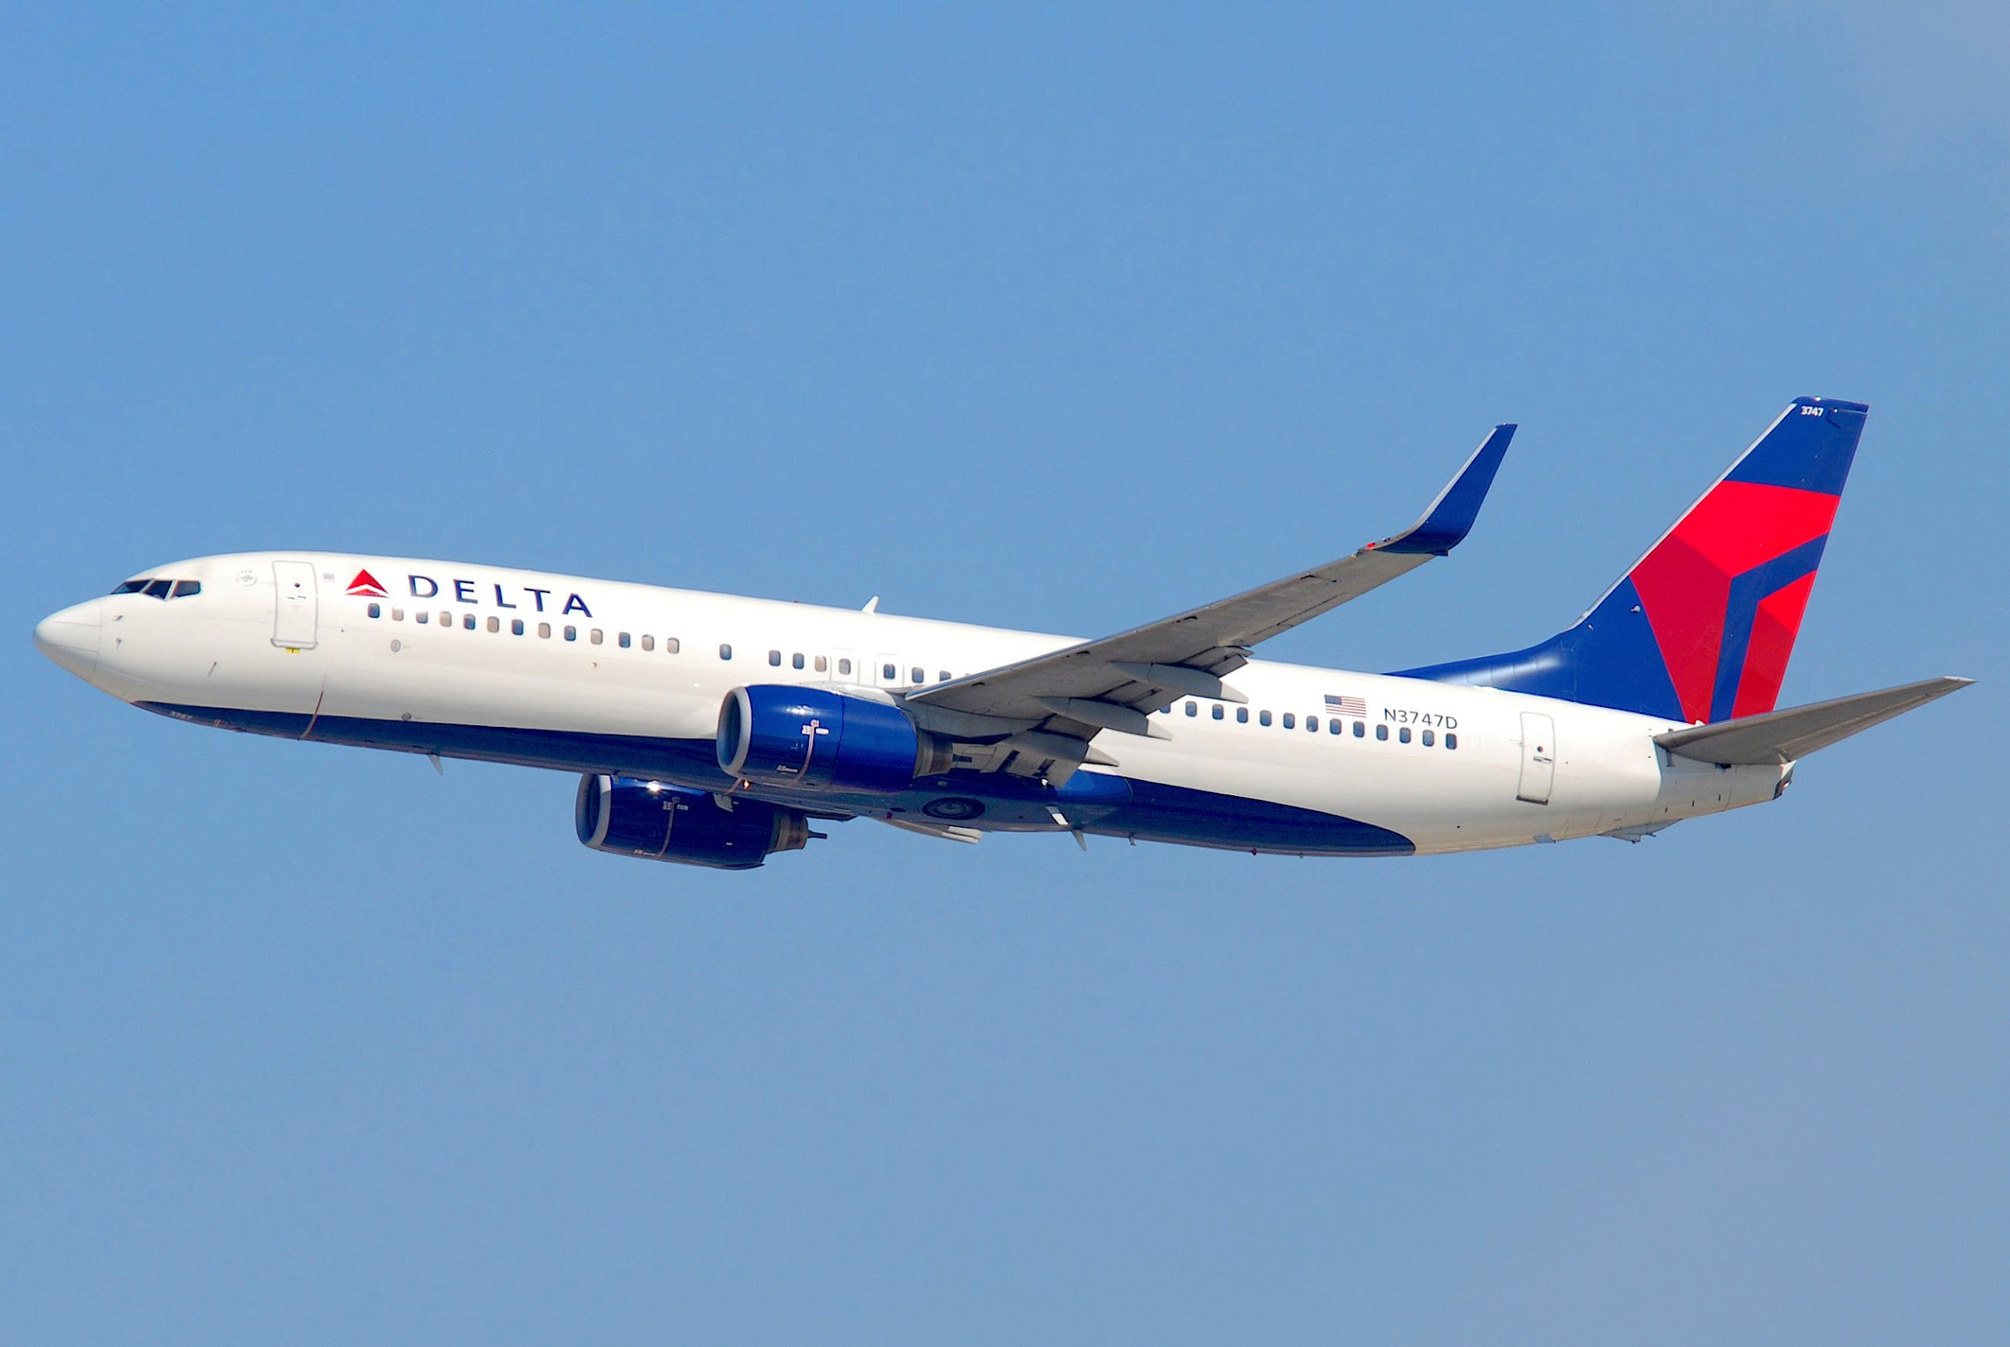
Boeing 737/777

Slide 18

Private - Cessna 172/182
Alternate - Cirrus SR20/SR22

Slide 19
Future Insights

Slide 20

Future Insights
Total number of flights
Compare ROI between commercial and private planes
Consumer demand for commercial vs. private

Slide 21
Thank You
Lillian Lakes
lillian.lakes@gmail.com
Madeleine Smithers
madeleinedsmithers@gmail.com
Rajesh Reddy
rredd002@gmail.com

Slide 22
Questions?

